Slide 1

WAY TO ENTERPRISE
Java Basics
VTI ACADEMY
Author: duy.nguyenngoc1@vti.com.vn
March 2020

Slide 2
Agenda
JDBC Architecture
Operator
Maven
Properties File
Assignments
Copyright © VTI Academy All Rights Reserved

Slide 3
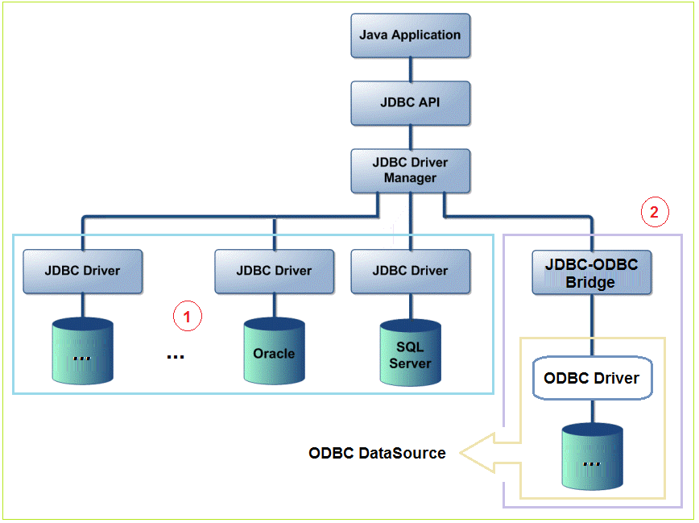
JDBC Architecture

Slide 4
Operator
CRUD
Call Procedure, function, …
Transaction

Slide 5
CRUD
Create
Get List & Get By Id
Update
Delete

Slide 6
CRUD Steps
Step 1: Setup library
Step 2: Get a connection to database
Step 3: Create a statement object
Step 4: Execute SQL query
Step 5: Handling Result Set
Step 6: Close connection

Slide 7
Step 1: Setup library
2 ways
Download .jar file
Maven

Slide 8
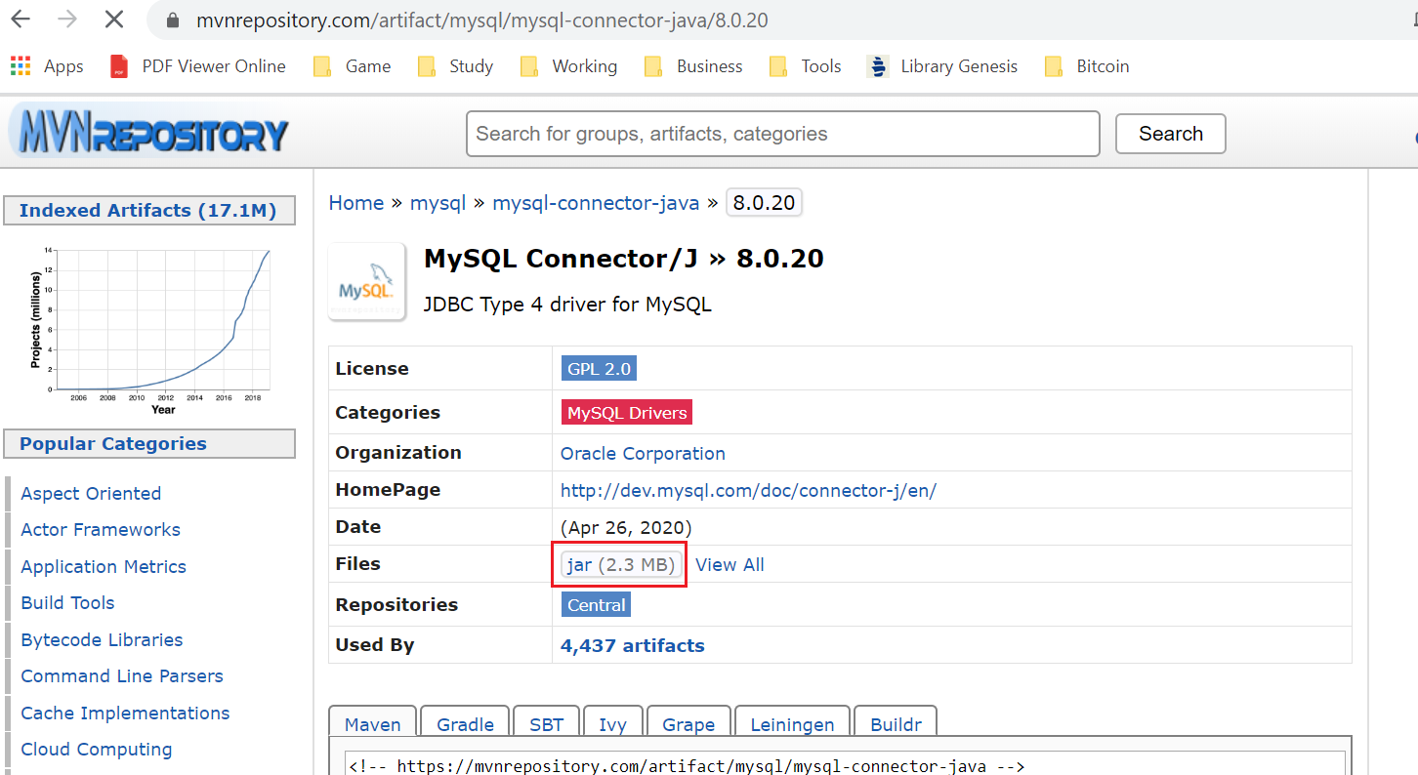
Download .jar file
Download JDBC connector MySQL maven java

Slide 9
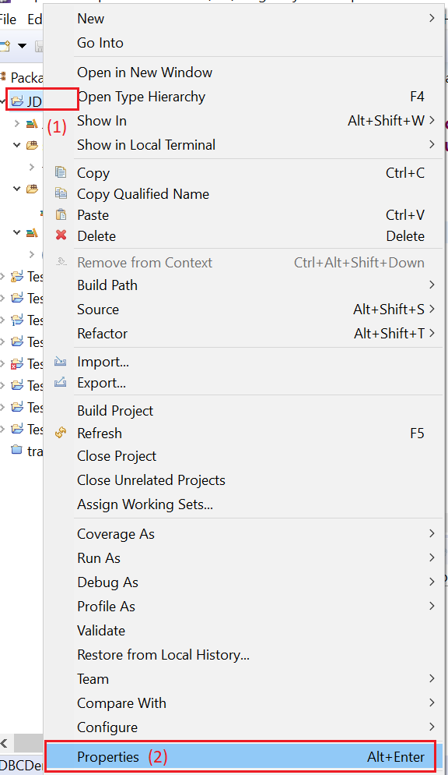
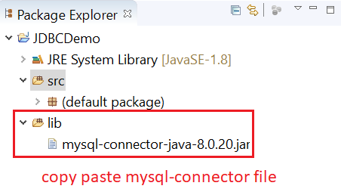
Download .jar file
Add library to Java

Slide 10
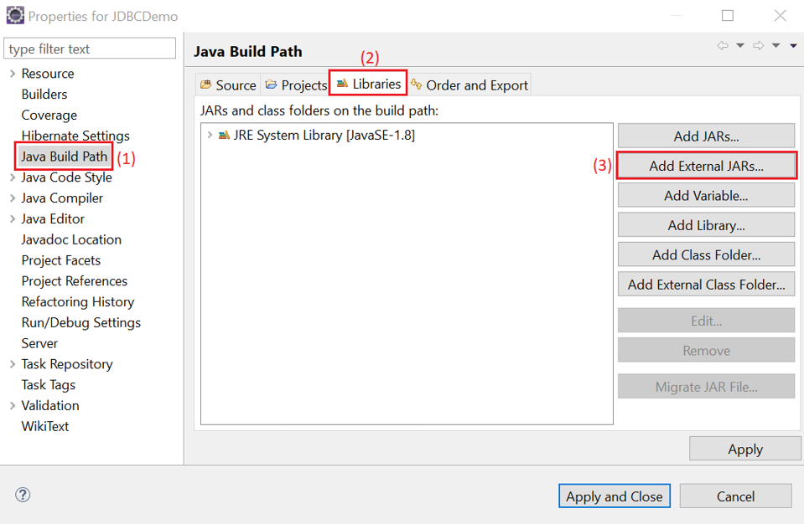
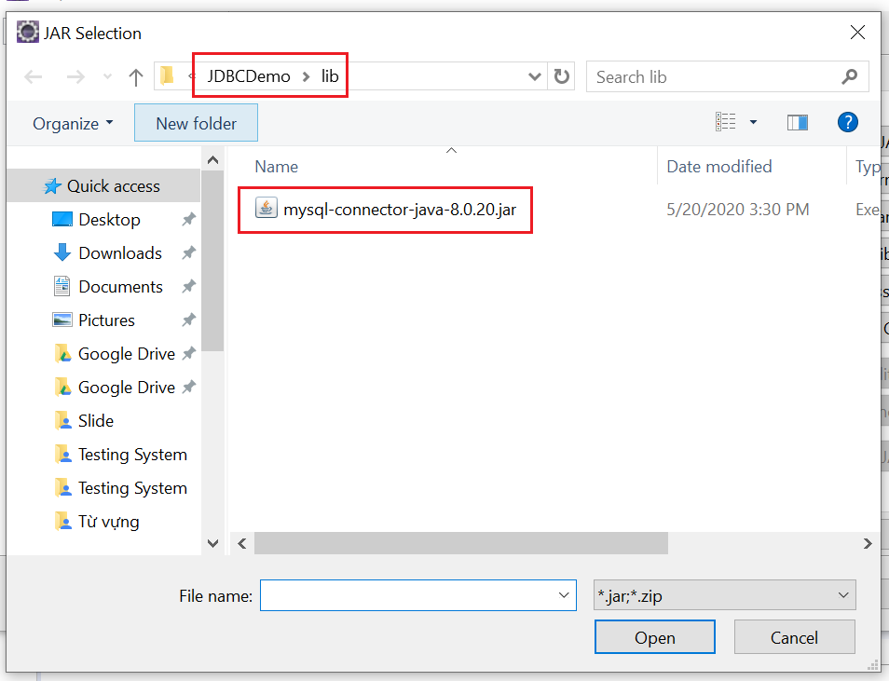
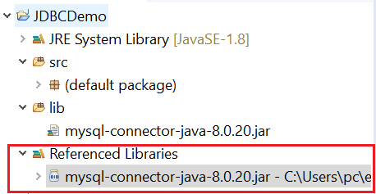
Download .jar file

Slide 11
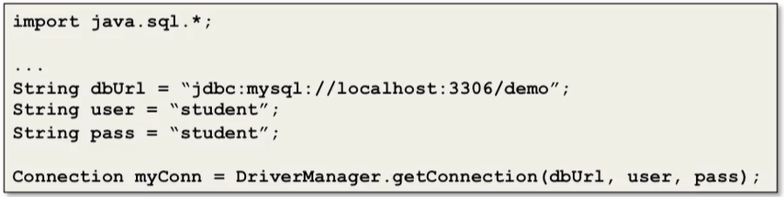
Step 2: Get a connection to database
Get a connection base on driver

Slide 12
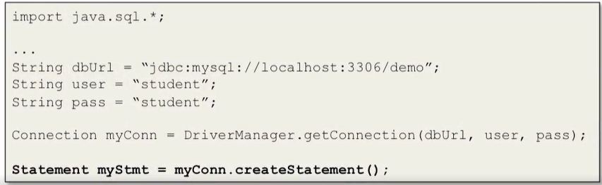
Step 3: Create a statement object
Statement Object for fixed statement
PreparedStatement Object for Statement which has parameter

Slide 13
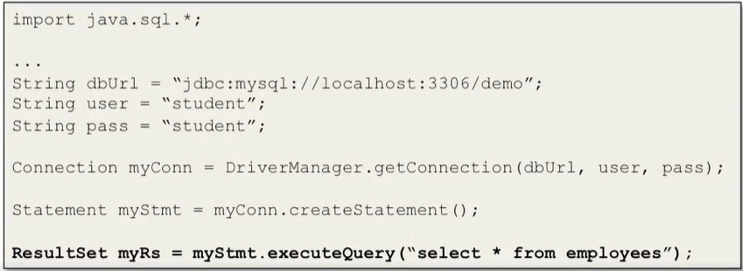
Step 4: Execute SQL query
executeQuery() uses for Select statement
executeUpdate() uses for Insert, Update, Delete statement

Slide 14
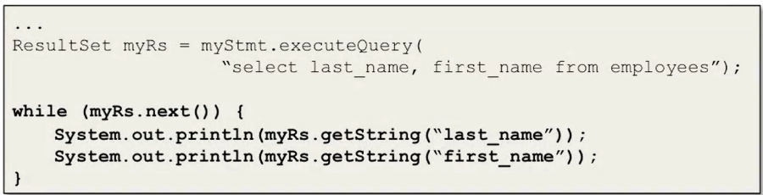
Step 5: Handling Result Set
Pointer will be before the first row of result set
Using ResultSet.next() method to next pointer to first row
Get value of column by index or column name

Slide 15
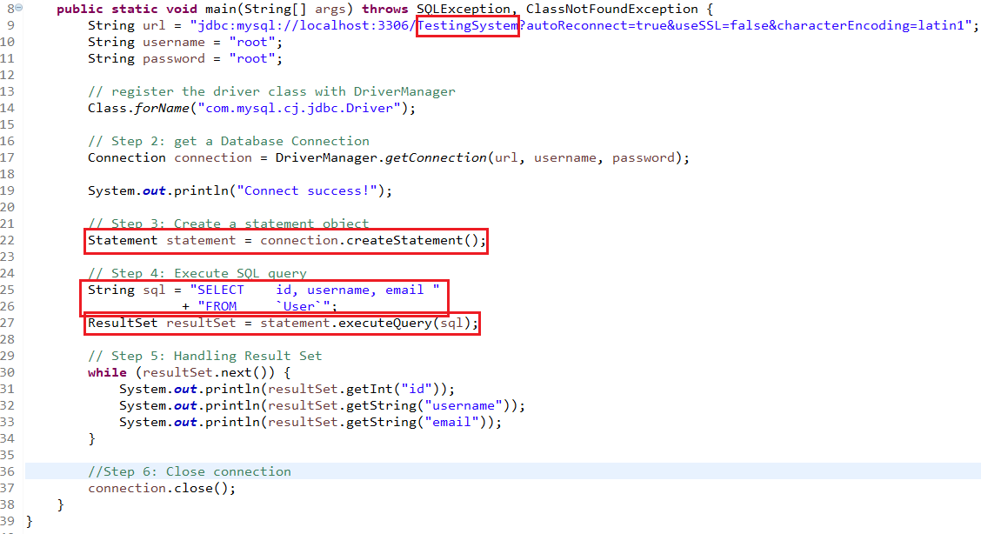
Example (read data)
Notes:
jdbc:mysql://localhost:3306/TestingSystem?autoReconnect=true&useSSL=false&characterEncoding=latin1
com.mysql.cj.jdbc.Driver

Slide 16
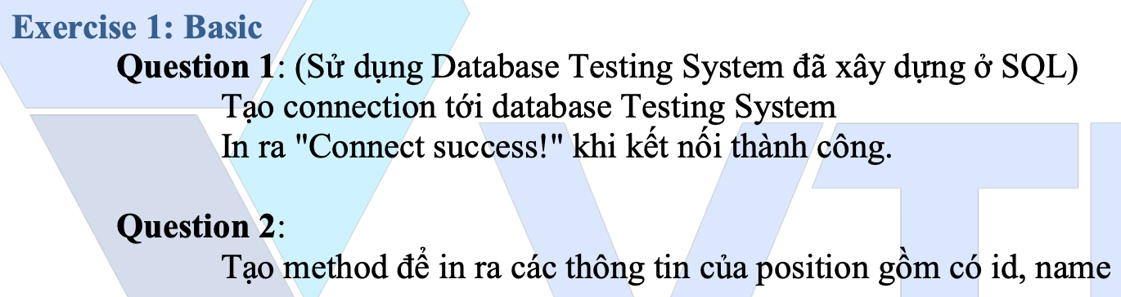
Testing System Assignments
Exercise 1: Basic - Question 1

Slide 17
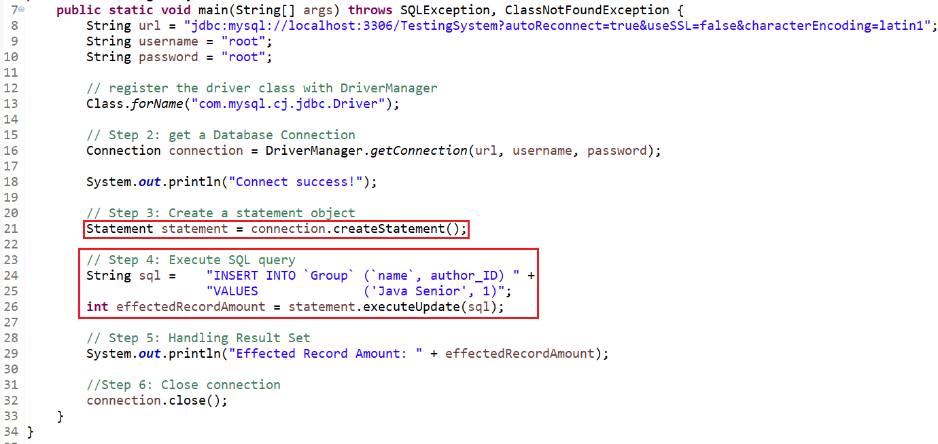
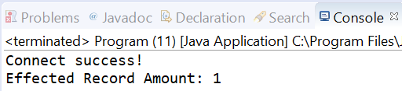
Example (create data – Statement Object)

Slide 18
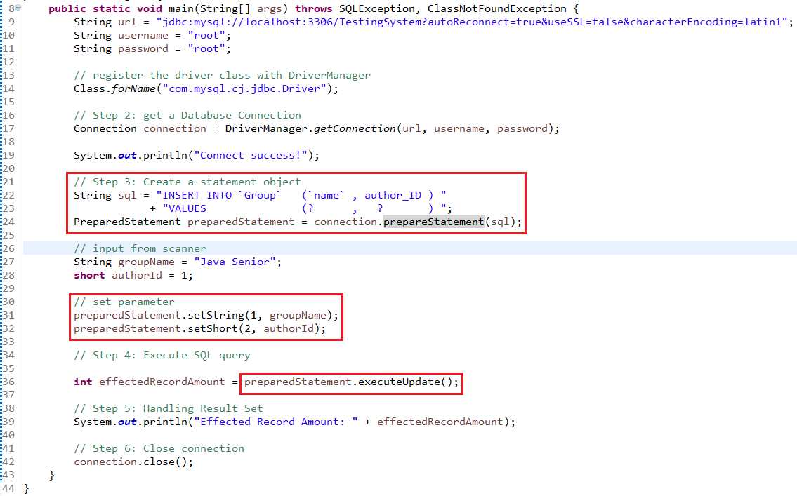
Example (create data – PreparedStatement Object)

Slide 19
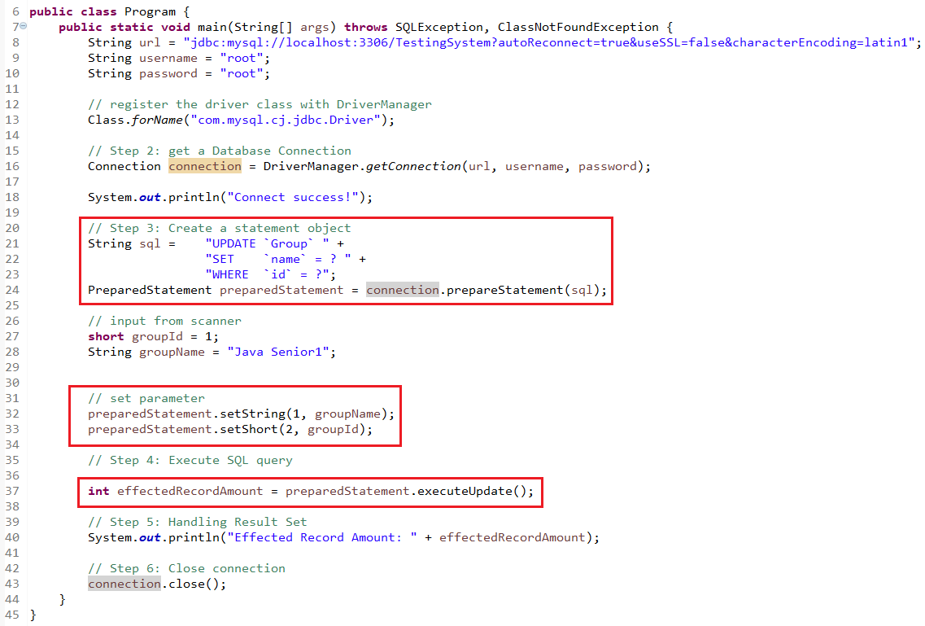
Example (update data)

Slide 20
Example (delete data)

Slide 21
Summary
Statement Object & PreparedStatement Object
executeQuery() & executeUpdate()

Slide 22
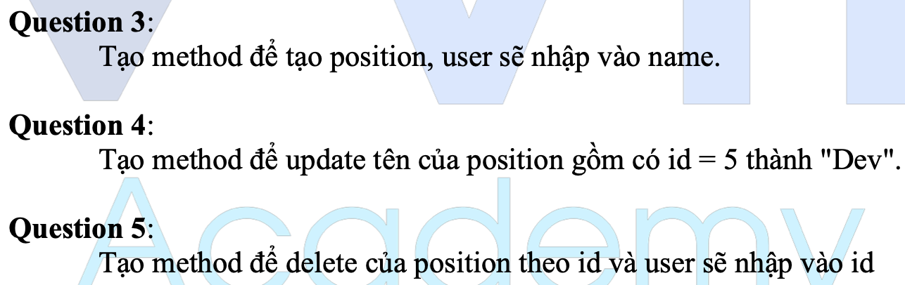
Testing System Assignments
Exercise 1: Basic - Question 3, 4, 5

Slide 23
Maven
Create maven Project
Add library
Operator
Install maven
Clean maven

Slide 24
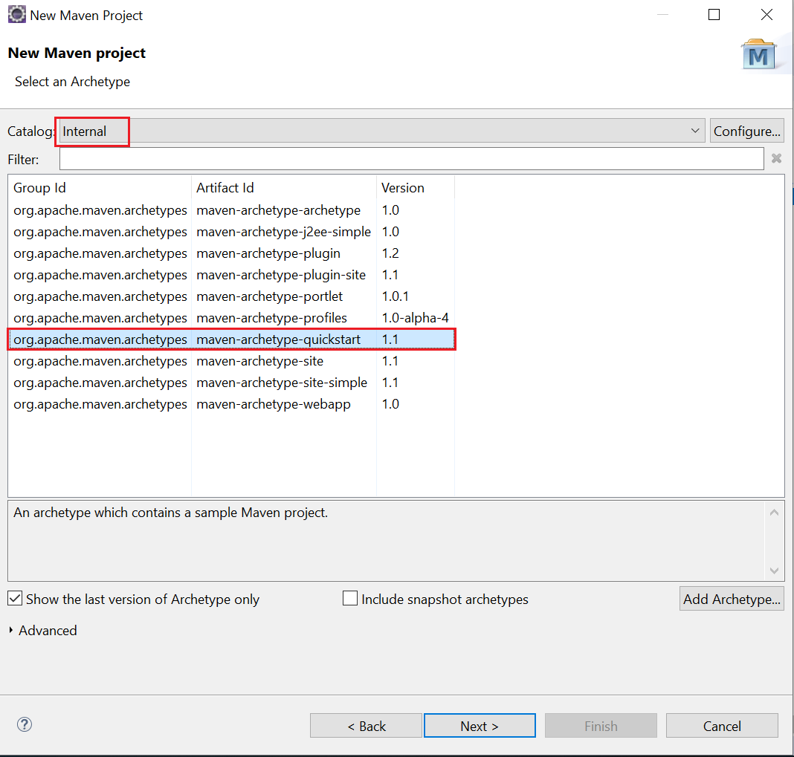
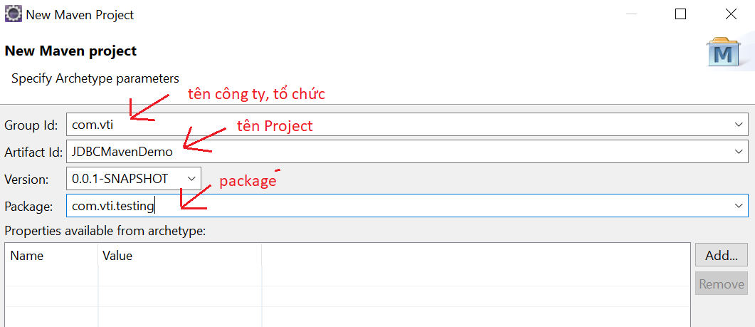
Create maven Project
New → Project → Maven Project → choose maven-archetype-quickstart

Slide 25
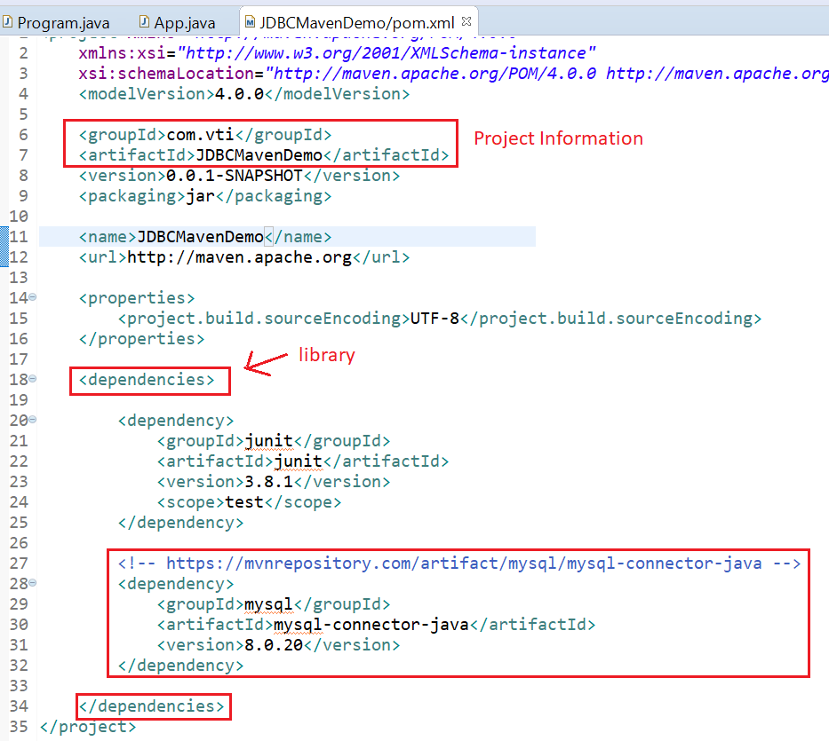
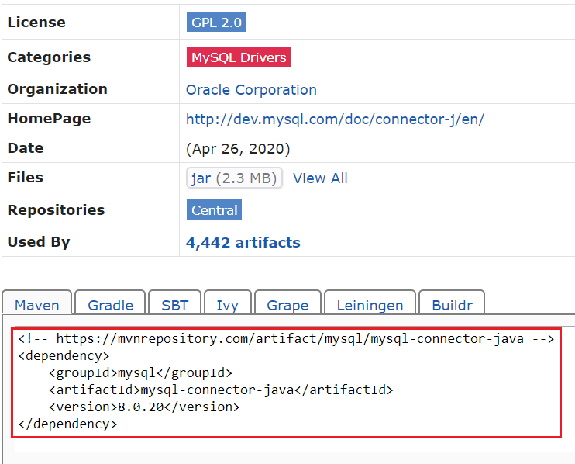
Add library

Slide 26
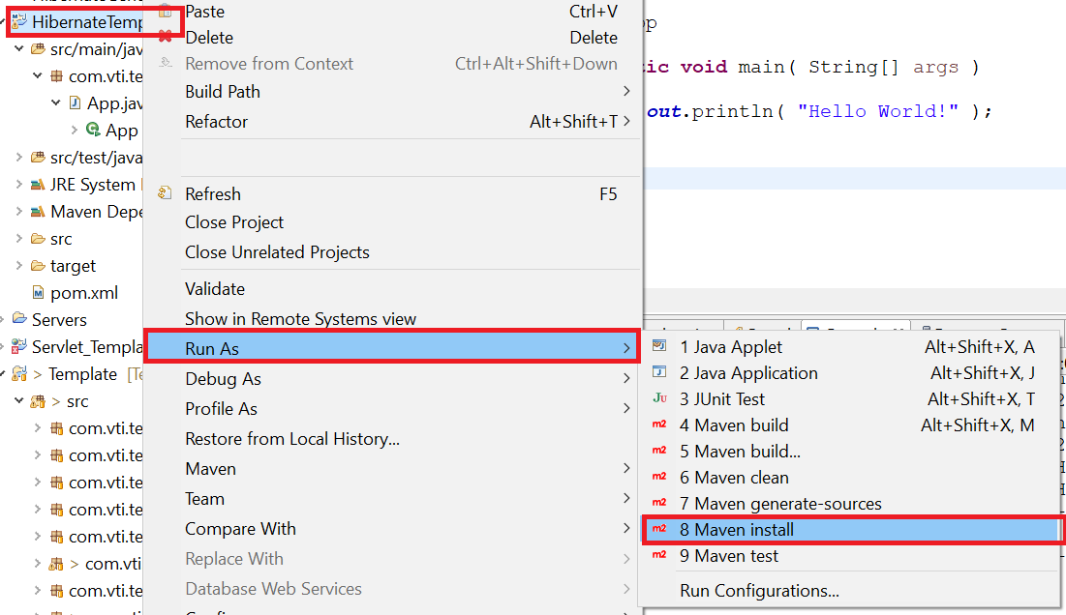
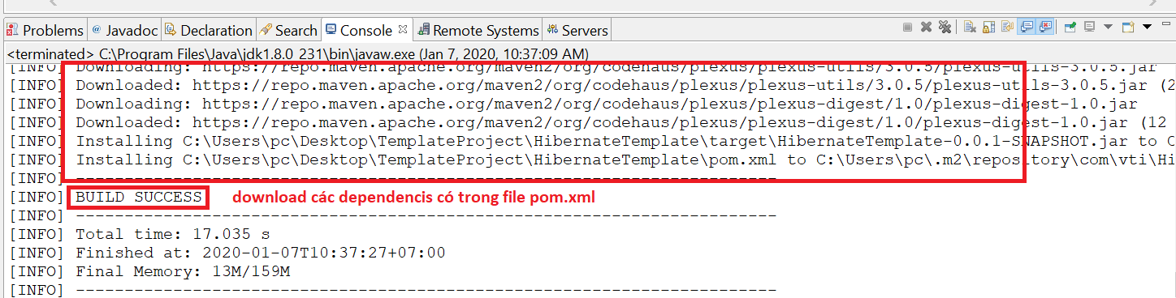
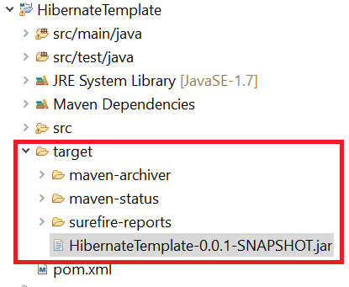
Install Maven

Slide 27
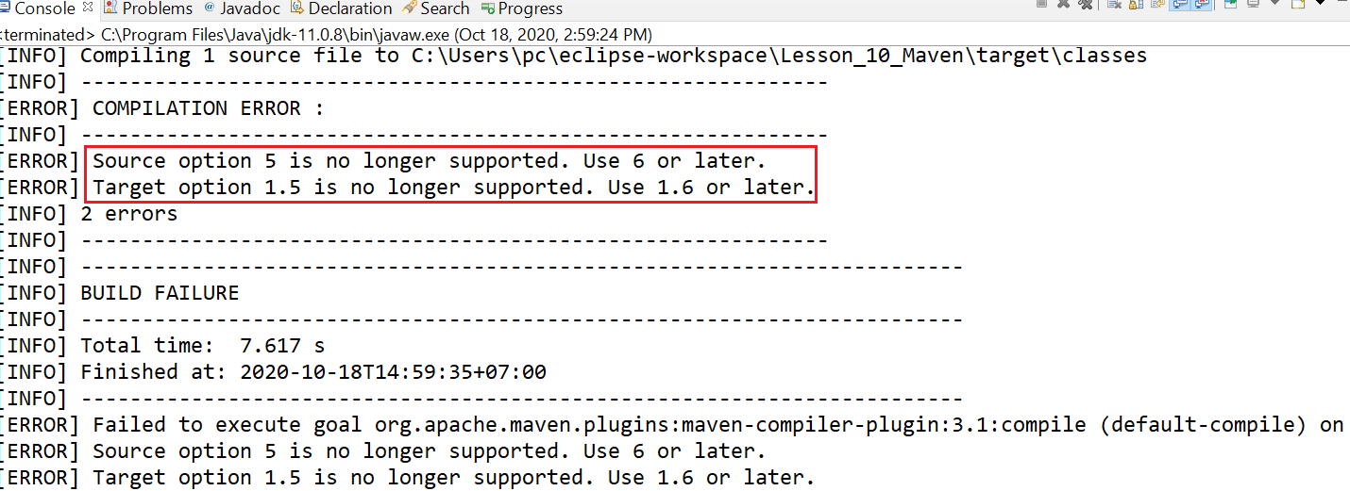
Error

Slide 28
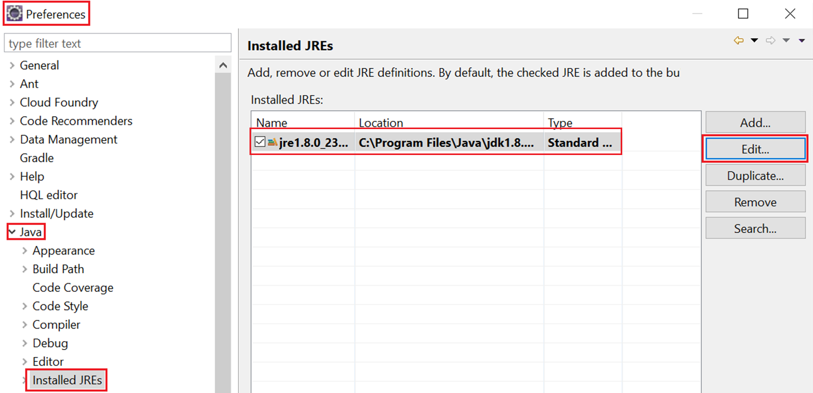
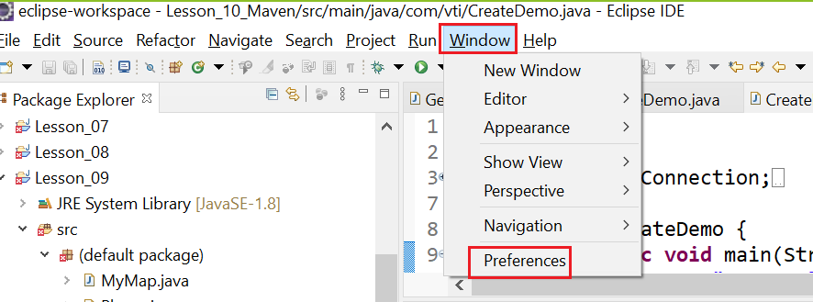
Fix error
B1: Config default JRE

Slide 29
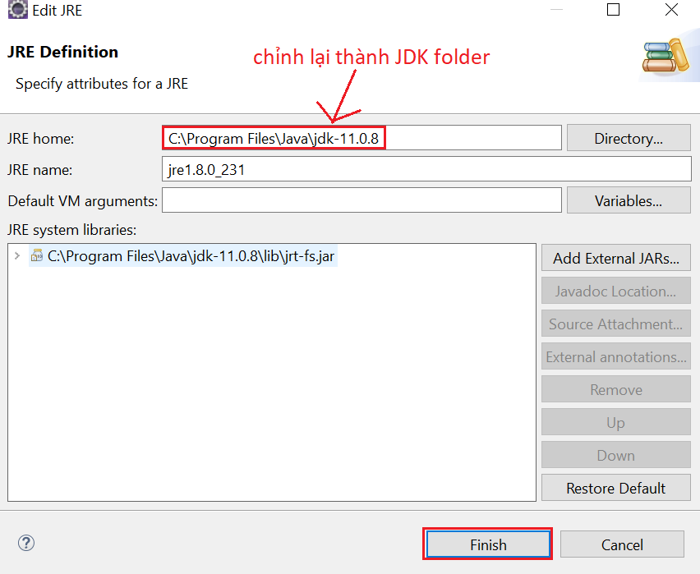
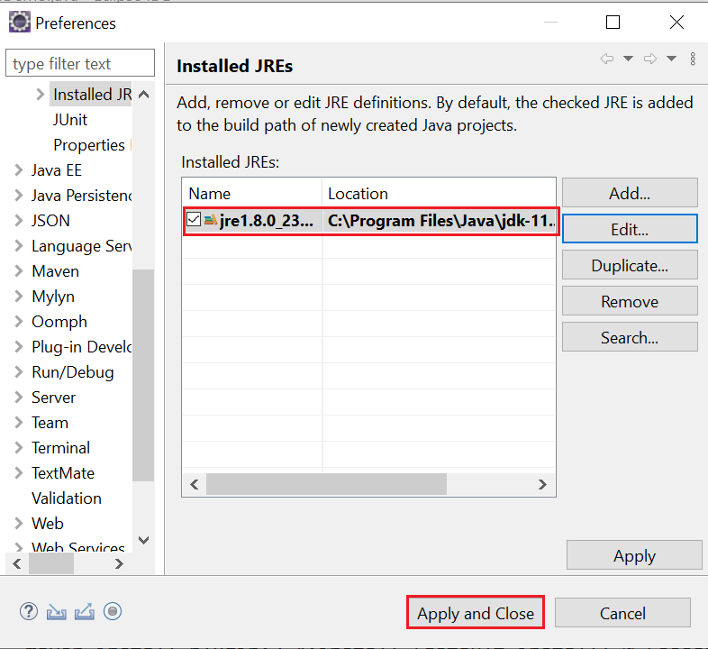
Fix error

Slide 30
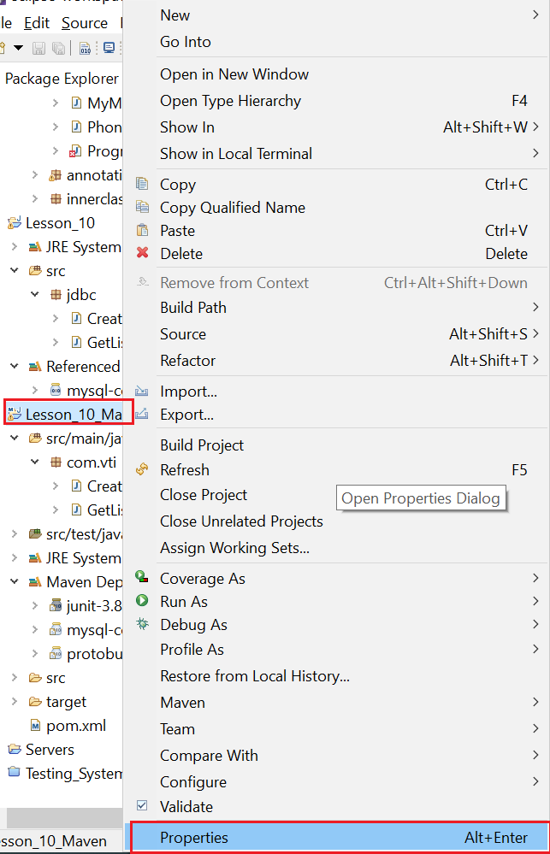
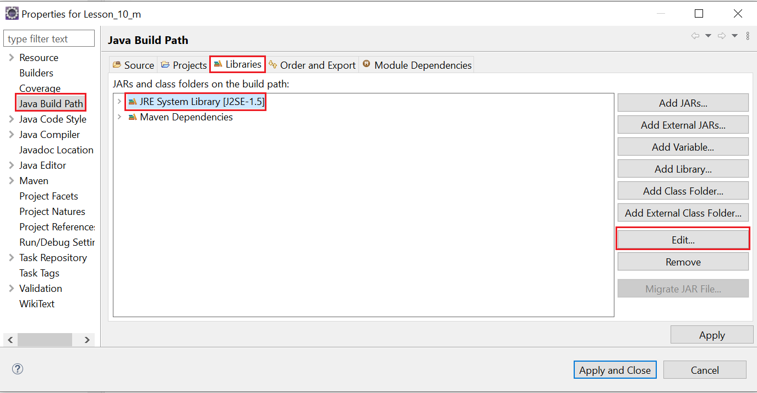
Fix error
B2: Config Project JRE

Slide 31
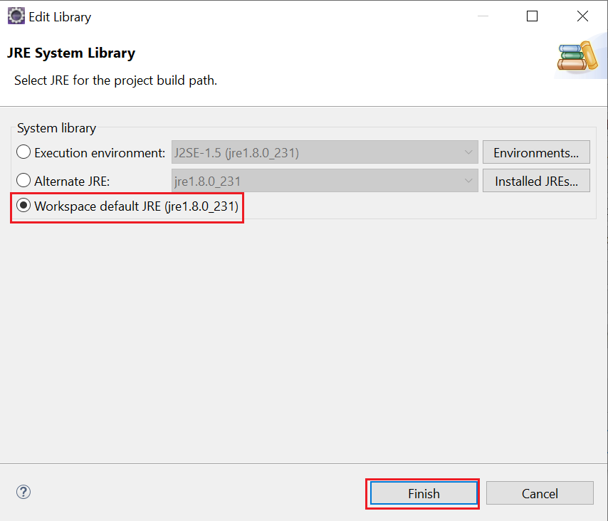
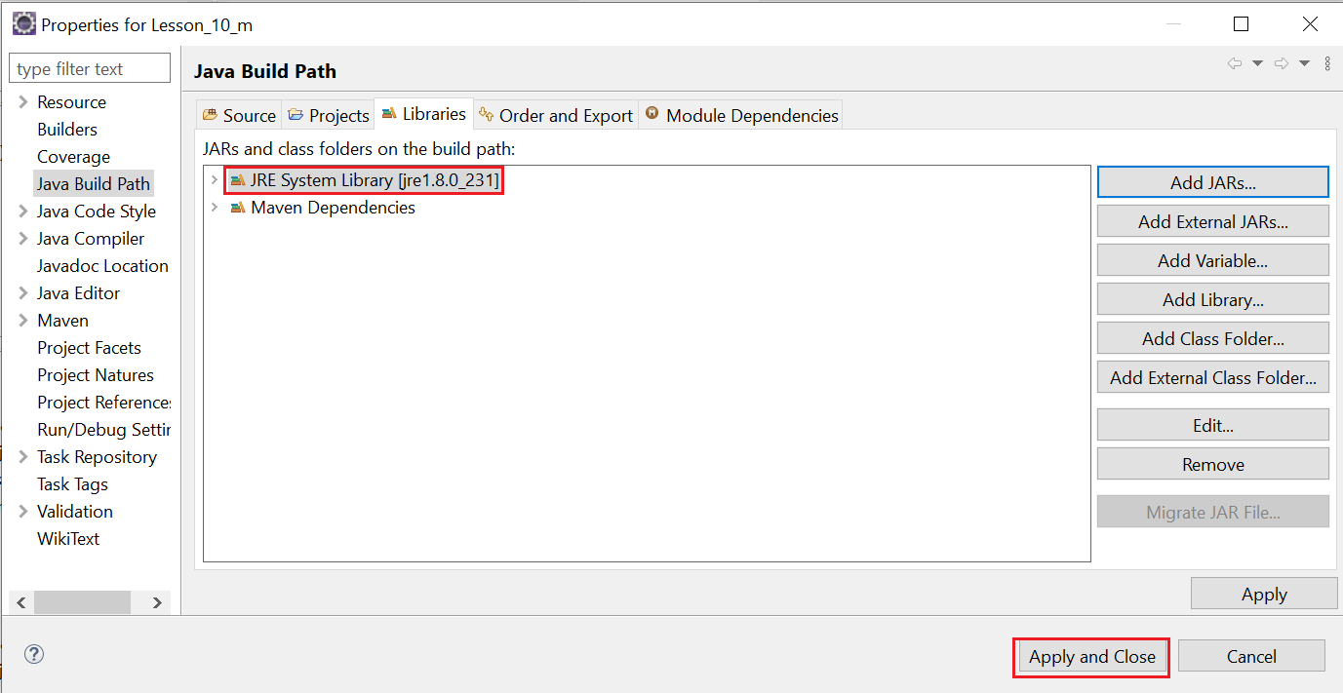
Fix error

Slide 32
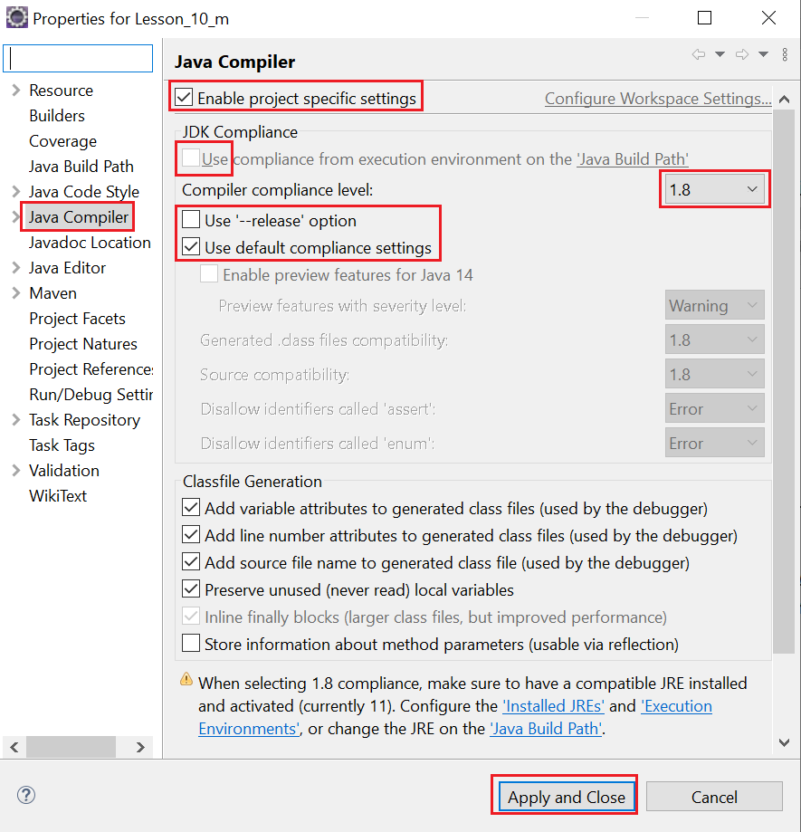
Fix error

Slide 33
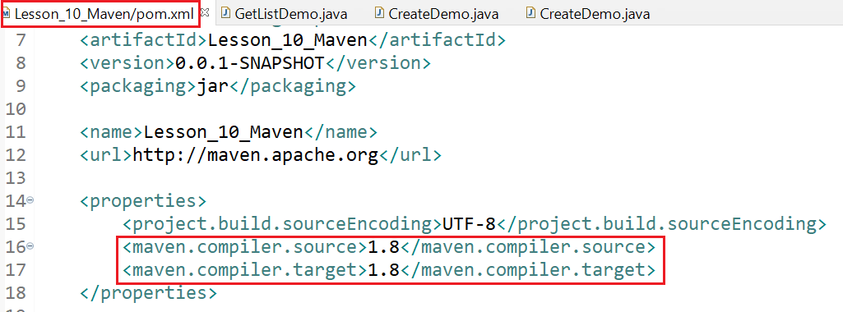
Fix error
B3:
https://stackoverflow.com/questions/49028810/error-source-option-1-5-is-no-longer-supported-use-1-6-or-later

Slide 34
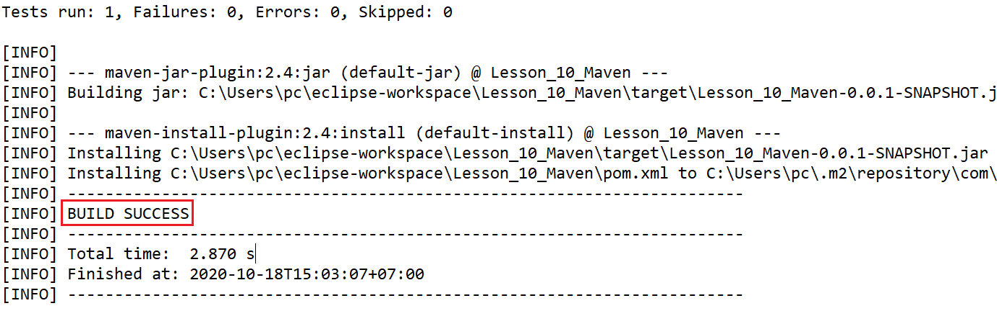
Fix error
B4: Install again!

Slide 35
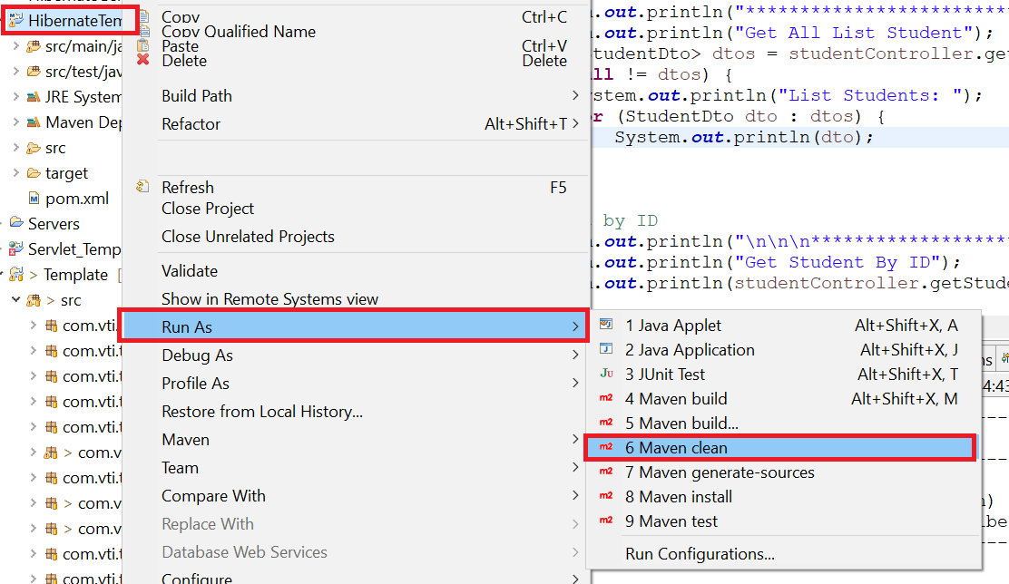
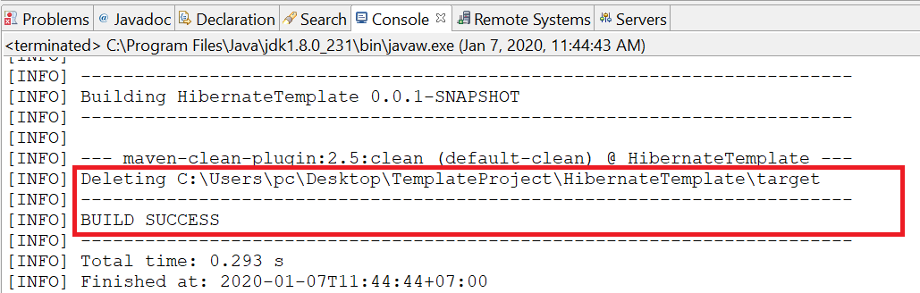
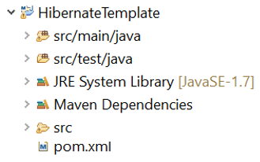
Clean maven

Slide 36
Properties File
Create properties File
Get Property

Slide 37
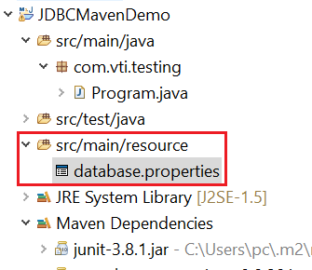
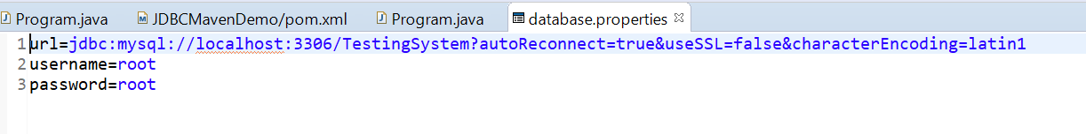
Create Properties File

Slide 38
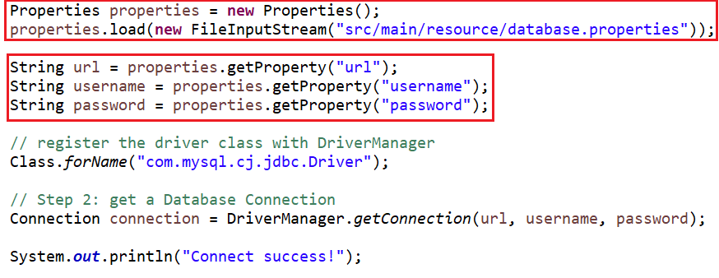
Get Property

Slide 39
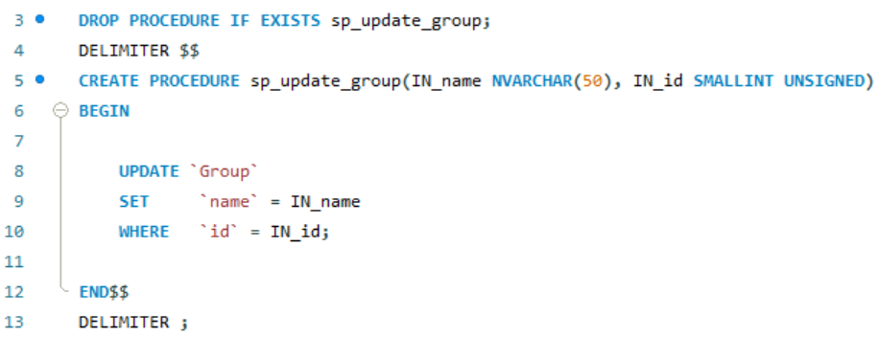
Call Procedure
SQL Procedure

Slide 40
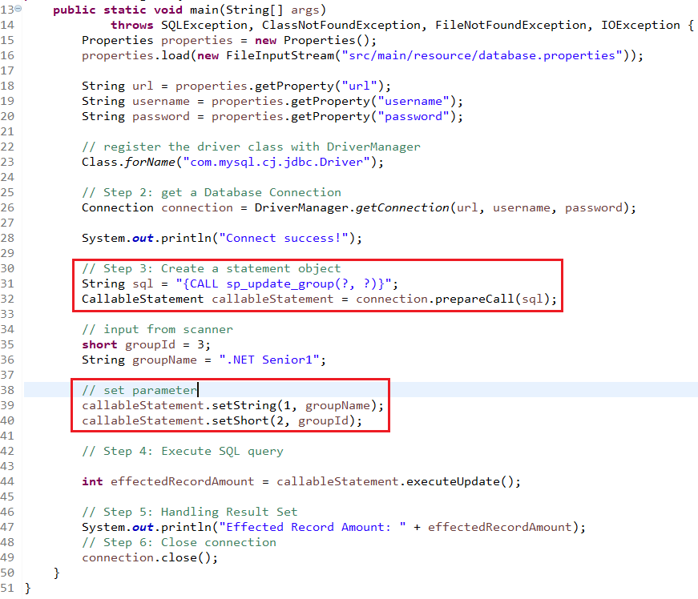
Call Procedure

Slide 41
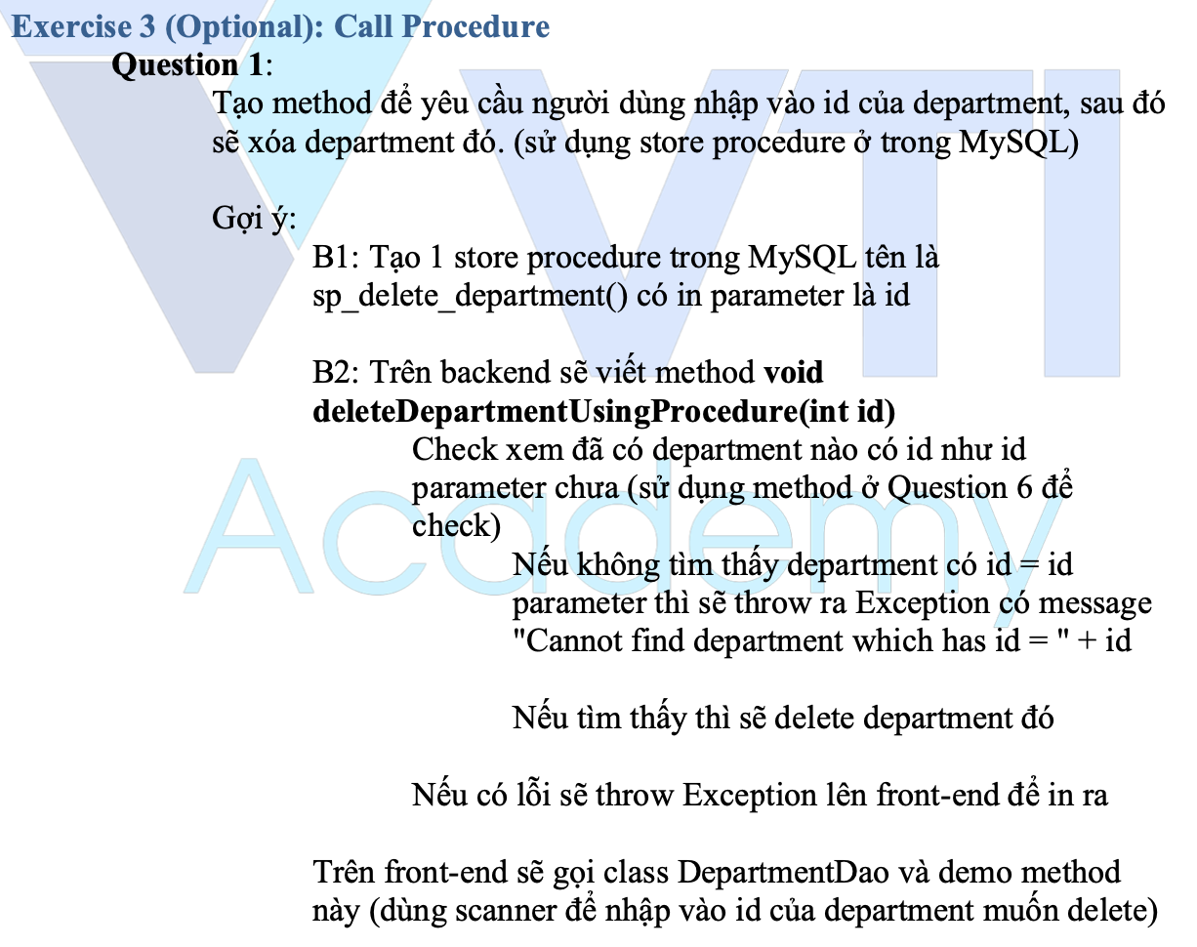
Testing System Assignments
Exercise 3 (Optional): Call Procedure

Slide 42
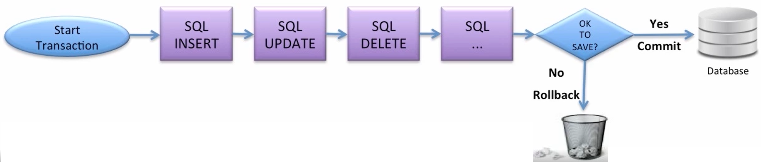
Transaction

Slide 43
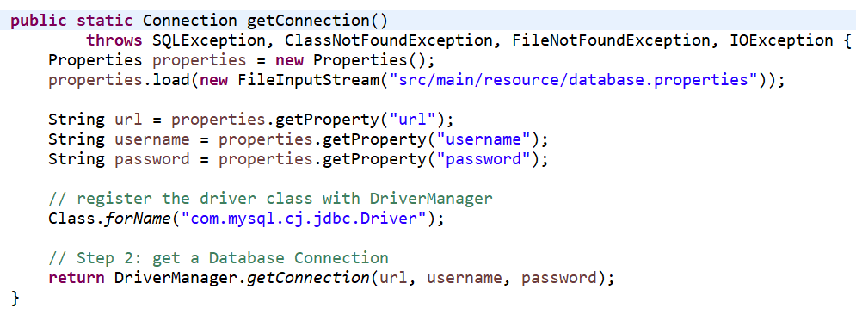
Transaction

Slide 44
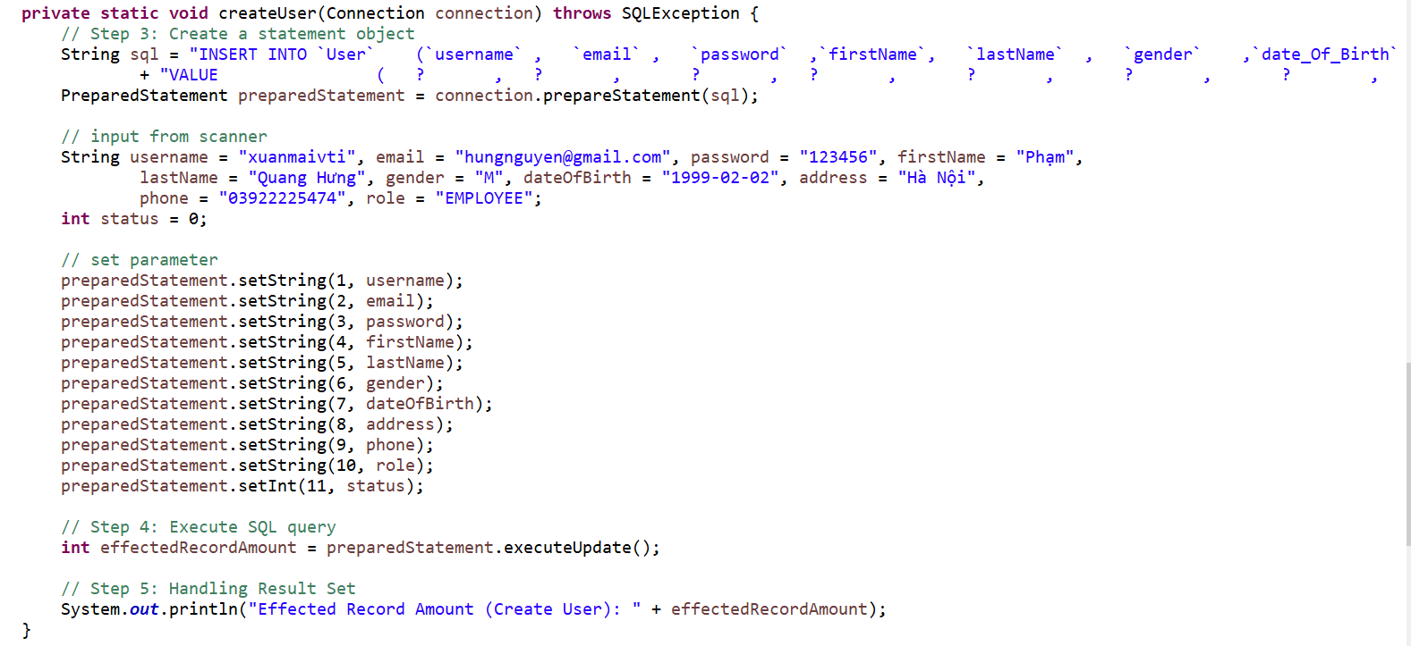
Transaction

Slide 45
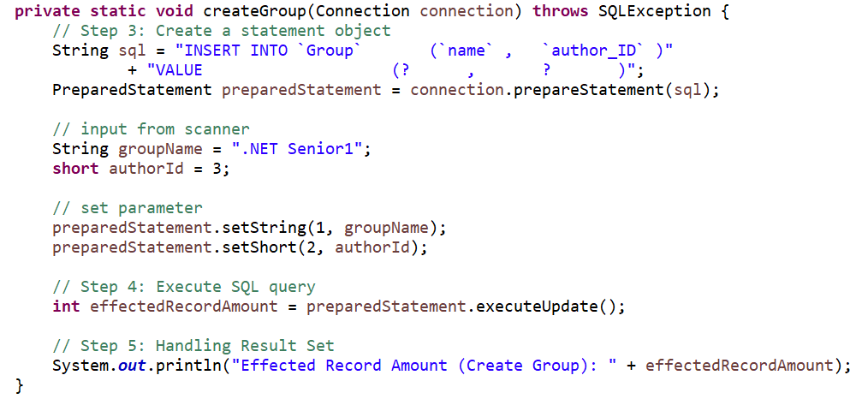

Transaction

Slide 46

Transaction

Slide 47

Testing System Assignments
Exercise 4 (Optional): Transaction

Slide 48

Testing System Assignments

Slide 49
Q & A
Copyright © VTI Academy All Rights Reserved

